Slide 1
Using the FCR

Slide 2

Facilitation
Photo: http://tinyurl.com/ybskl9mg

Slide 3
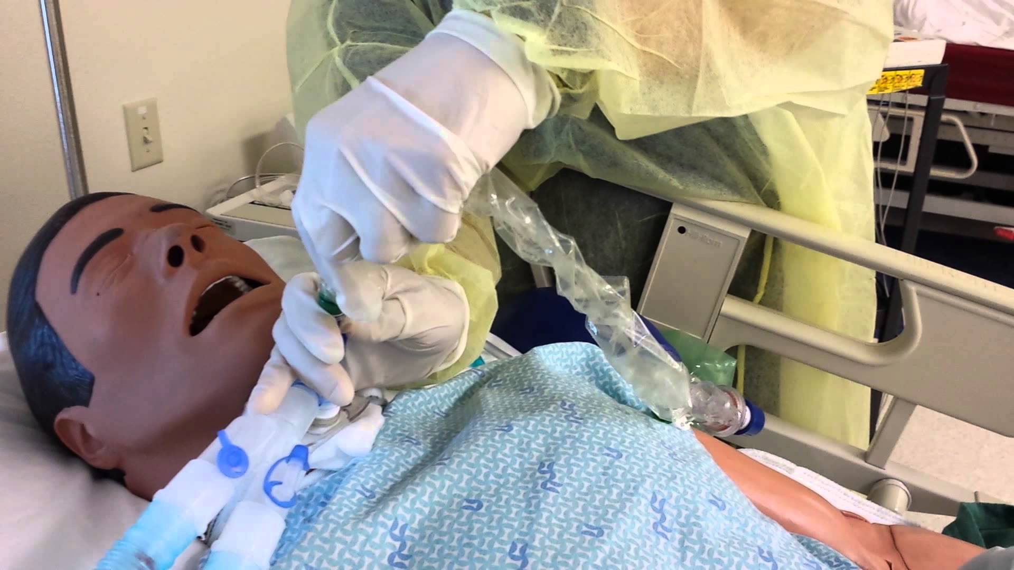

Facilitation

Slide 4

Facilitation
Photo: Times Higher Education

Slide 5
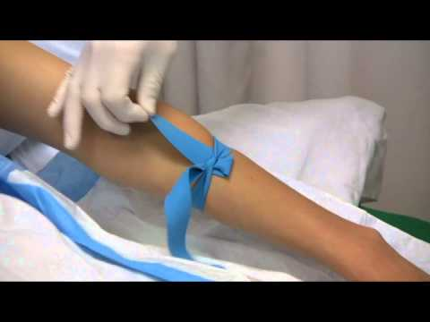
Facilitation
Photo: allnurseshelp.com

