Slide 1
From “Stuff” To Substance
Jane Kleinman, RN, MAOM
CEO
Performance Gap Solutions
www.performimprove.com

Slide 2
Overview
My Focus
“Turn What We Know Into What We Do”
Pro-Actively Identify & Mitigate Performance Gaps
Functional Application Models
Outcomes
Presentation Focus
Current State & Why
Key Needs For Success
Functional Understanding
Roadblocks & Tips For Success

Slide 3
We Know The Educational Gap
Education Environment
Practice Environment
Didactic
Testing
Silos Of Dogma
Static Environment
Interactive
Evaluation
Inter Professional
Dynamic Environment

Slide 4
We Know The Practice Gap
What We Know
What We Do

Slide 5
We Know What We Want
Knowledge Into Actions
Safe Patient Care
Cognitive
Technical
Behavioral
Right Actions
Right Time
Right Reasons
Right Delivery
Seemless Integration

Slide 6
Outcomes
Performance Gaps Identified
Performance Improvement
System Contributing Factors Identified
System Improvement
Cost Reductions
Confidence
Competence
Satisfaction

Slide 7
So We Evolved Our Simulation Training
Skills, Tasks & Procedures
Lecture Animation
Immersive Patient Care Management
Practice On Body Parts
Case Study With Guided Demonstrations
Experiential Role Play

Slide 9
What We Have Ended Up With
FOCUS
Technology Driving Methodology Instead Of Supporting Methodology
Ad Hoc Case Study Experiences
ACTIVITY
Pockets Instead Of Program Integrated Across The Continuum
Sporadic Use Instead Of Logical Implementation
MEASURES
Variable Definitions & Methodologies Causing Unreliable Outcomes

Slide 10
Why Is This So Difficult?
Health Care Developing Own Pedagogy
Silos of Dogma & Limited Inter-Professional
Lacks Defined Taxonomy & Nomenclature
< 10 Years Of Ill Defined Evolution
Limited Academic Rigor
Initial Vendor Driven Technology Solutions
Latest Tour Syndrome
Not Understanding The Logistics To Be Supported
Variable Methodologies

Slide 11
Roadblocks To Success
Buy Equipment Before Program, Business, & Operations Plan Developed
Personal Agenda Drivers
Lack Of Programmatic Approach
Variable Methodologies
Not Understanding & Supporting The Resources Necessary
Silos Of Dogma
Latest Tour Syndrome

Slide 12
BRAIN TRUST
Inter-Professional
Shared Mental Model
Resource Pool
PROCESS INTEGRITY
Time Efficient
Roles & Goals Timeline
Piloting & Evaluation
Same Methodology
OUTCOMES
Linked To Core Indicators
Performance Measure Data
Hard & Soft ROI

Slide 13
Shared Mental Model Key Questions
Philosophy & Methodology?
Procedure Or Patient Care Management
Formative Or Summative
Integrated Program Or Individual Uses
Additional Experience Or Inculcated
Open Or Confidential
Standardization Or Ad Hoc
Data For Outcomes

Slide 14
Shared Mental Model Key Questions
Operational Parameters & Resources?
Types Of Experiences Provided Where
Types Of Learner Groups
How Experiences Provided
Utilization Projects For Space, Equipment & Personnel Support
Leaner Group Unique Needs & Thru-Put
Technology Interface, Integration & Operations
Budget

Slide 15
Shared Mental Model Answers Impact Planning
Decisions & Plan
Space Allocation, Design, Flow
Utilization
Equipment
Infrastructure
Personnel
Daily Operations
Budget

Slide 16
Tips For Success Shared Mental Model
Stakeholders
Who Is Doing What
Town Halls
Diverse Participants
Depth Of Perspectives
Development
Defined Roles
Defined Activities
Who Needs What
Who Drives What
Optimization Of Resources
Decision Makers
Nay Sayers
Defined Time Line
Defined Resources
External Neutral Voice

Slide 17
Tips For Success Shared Mental Model
Utilization
Types Of Experiences
Learner Groups & Levels
Operations
Standardized Methodology
Methodology Impacts On Resources
Fidelity
Environment
Equipment & Supplies
Focus
Staffing Model
Immersive Experience

Slide 18
Tips For Success Shared Mental Model
Program Design
Inter-Professional
Across Continuum
Investment
Outcome Measures
Linked To Core Indicators
Knowledge Into Actions
Financial Investment
Time Investment
Sustainability
Learner Groups
Types Of Experiences
Targeted Problems Based On Current Data

Slide 19
Roadblocks To Success Operational Logistics
No Technician
IPCMS Is An Add On To Current Work Load
Variable Methodologies
Mix Summative With Formative
No Policy & Procedure
< 3 x Per Month Facilitator/Debriefer
Loss Of Confidentiality
Lack Of Collaborative Brain Trust For Scenario Development

Slide 20
Standardized Methodology
Learner Experience
Educator Experience
Process Not Personality Driven
Consistency + Clarity = Ability To Measure Outcomes
Consistency + Clarity = Safety
Ability To Risk Exposure Of Performance Gaps

Slide 21
Methodology Development
Program
2 Months To Define
2 Months To Plan
Scenario Writing
3-5 Experts
40 Total Man Hours Per
Core Providers Training
32 Hours Methodology
8 Hours Mentoring
$2500-$3500 Per
2 Months To Implement
Ownership
Core Providers
32 Hours Buttonology

Slide 22
Methodology Utilization
Timeline
30 Minutes Per
20 Minute Debriefing
Learner Thru-Put
Learner Group Of 5-10
Rotate Participation & Observation
Options
JIT In-Situ 1 Hour
2 Experiences Per Hour
10 Minute Experience
4 Hour Block
8 Hour Block

Slide 23
Methodology Providing The Experience
Zones
Experience Area
Observation/Debriefing Area
Equipment
Video
Content Expert
1 Technicial + 1 Facilitator/Debriefer
Team
Control Station Area
Manikin
Patient Care
Disposable Supplies
Per Experience

Slide 24
Methodology Basic Costs
2.5 FTEs
1 Tech
1 Facilitator/Debriefer
½ Support
$175,000 Year
Equipment
$500,000 Initial
$25,000 Annual
Consumable Supplies
$15,000 Initial
$1500 Annual
Supports 348 Sessions & 3840 Learners Per Year

Slide 25
Methodology Tips Operations
Standards
Policy & Procedure
Processes
Scheduling
Block Schedule
Assigned Providers
Providers
Resource Pool
Core Group
DFUs All Equipment
Same Methodology

Slide 26
Methodology Tips Provider Training
Technician
40 Hours Buttononology
32 Hours Methodology
Facilitator Debriefer
32 Hours Methodology
8 Hours Mentoring
Content Expert
8 Hours Scenario Writing
Role Guidelines For Assistance
Manages All Equipment
Manages Experience
Assists With Experience If Needed

Slide 27
Methodology Tips Provider Training
Off-Site Considerations
$4300 Per
Minimum Of 3 To Create Core
On-Site Considerations
$1250 Per
5-15 To Create Core
Ability To See & Use Right Set Up
Ability To Customize To Special Needs
Diversity Of Participants
Combine Mentoring With Pilot Program

Slide 28
Roadblocks To Success ROI With Measurable Outcomes
Personal Agenda Drivers
Not Defining The Problems To Solve
Lack Of Performance Expectations Across A Continuum
Ambiguous Performance Measures
Testing

Slide 29
ROI With Measurable Outcomes
Problem Identification
Problem Solution
Experiences Designed To Challenge
Cost Benefit
Cost Per Learner Per Experience VS Cost Of Ongoing Problem
Objective Evaluation
Standards VS Actions
Risk Management Data
Licensure Test Plan Categories
Defined Performance Measures
Meaningful To Stakeholders
Core Indicator Data

Slide 30
Example ROI Outcomes
Dartmouth-Hitchcock Medical Center integrated simulation with competency development in nurse residency program
• Decreased nurse turnover by 70 percent
• Increased retention by nearly 50 percent after 18 months
• Decreased vacancy rate to 3 percent
• Decreased length of orientation
- Med/Surg from 26 weeks average to 14 weeks average
- Critical Care from 32 weeks average to 22 weeks average
- NICU from 34 weeks average to 24 weeks average
Excerpts from Mary Patterson’s 9/21/07 Grand Rounds Video “Medical Simulation: Current State and Future Direction.”

Slide 31
Example ROI Outcomes
University of Pittsburgh airway management mishap claims have decreased from an average of 24 per year to less than 10
Harvard noted a 50% decrease in malpractice claims for anesthesiologists that have attended a simulation-based risk reduction course
Beth Israel in Boston decreased the number of adverse events in obstetrics by 50% since they instituted a simulation-based risk reduction program
Excerpts from Mary Patterson’s 9/21/07 Grand Rounds Video “Medical Simulation: Current State and Future Direction.”
Michael DeVita, University of Pittsburgh, Wiser Center, Luke Soto. Harvard Risk Management Foundation

Slide 32
Tips For Success ROI With Measurable Outcomes
Target 3 Costly Problems
Procedure
Communication
Across The Continuum
Experience In Context
Accepted Best Practice Standard
Use Outcomes
Targeted Mitigation
Contributing Factors Identification
Policy

Slide 33
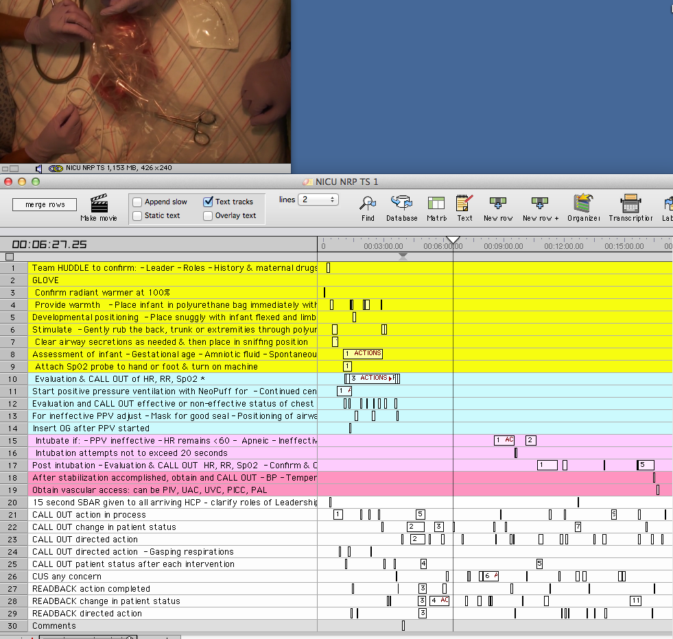

Slide 34
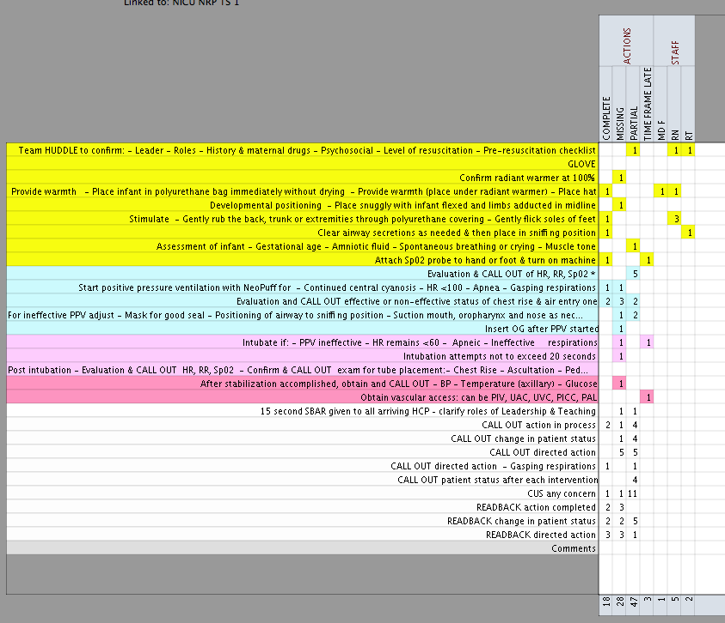

Slide 35
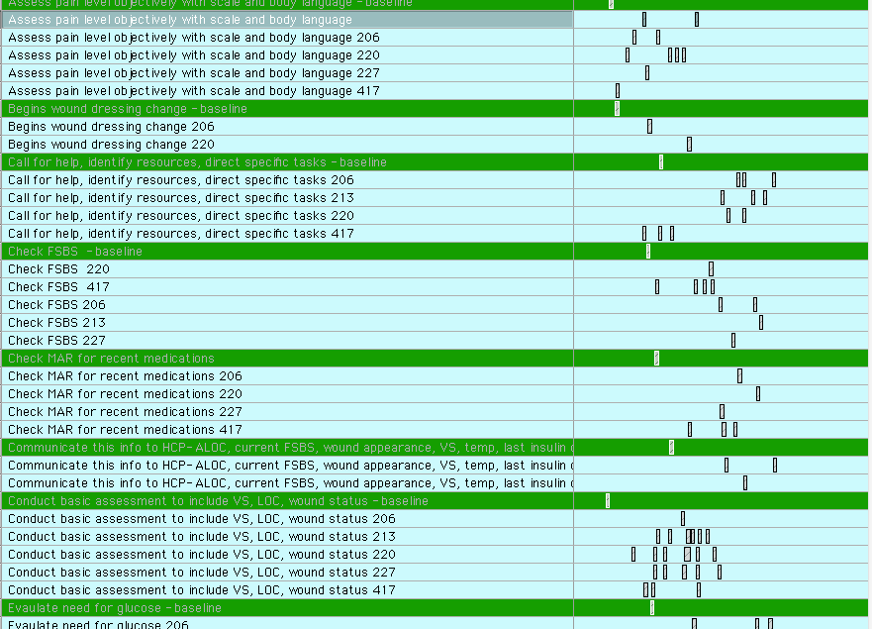

Slide 36
IPCM Scenario Outcome Dashboard

Slide 37
Tips For Success Motivators For Buy In
$$
Decreased Premiums
Value
Roles
Safe & Confidential
Easy To Access & Use
Pay For Performance
Training Dollar Allocation
Time Allocated
Process Not Personalities
Scenarios As Publication
Clear Expectations
Professional Experience
Improved Outcomes
Quality

Slide 38
Tips For Success Motivators For Buy In
Compliance
Accreditation
CME/CEU
Contributing Factors
Systems Analysis
Needs
Communication
Inter-Professional
Common Language
Regulatory
Teamwork
Systems Design Trial

Slide 39
Tips For Success Implementation
Rapid Deployment
Momentum
Credibility
Month 1-2
Stakeholder Town Halls
Shared Mental Model
Month 3-4
Provider Training
Phased Funding Commitment
Standardized Methodology
Minimal Equipment
Pilot Lunch Plan
5 Scenarios Created

Slide 40
Tips For Success Implementation
Pilot Program
Limited Exposure
Pilot Program
Operations Trial
Educator Team Practice
Pilot Program
Demonstration Model
Limited Expense
Grace
Refine Processes
Internal PR
Outcomes

Slide 41
Tips For Success Implementation
Pilot Program
1 Area
Pilot Program
Have Mentoring Help Present
Pilot Program
2 Months Prep Internal PR
Decision Makers Lead PR
1 Learner Group of 10 Per Day
5 Days In A Row
Have Mid Management Participate As Learners

Slide 42
Improved Patient Care
Program With Standardized Methodology
Performance Measures Linked To Core Indicators
Operational Logistics To Support Different Pedagogy
Outcome Tracking For Problem Identification & Pro-Active Mitigation

Slide 43
Summary
It’s About The Methodology Not The Technology
Methodology Impacts Planning
Planning Impacts Outcomes
Outcomes Support Sustainability

