Slide 1

Business Development for Revenue Generation
Developing a profitable Healthcare Simulation Center
for long-term program success.
Lance Baily
Sim Tech
Program Administrator
Consultant
Entrepreneur

Slide 2
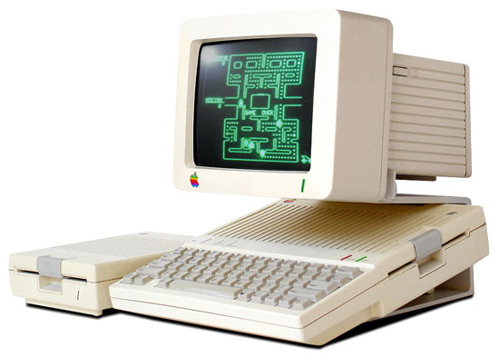
Why develop external business contracts?

Slide 3


Did you know you already run a business?

Slide 4

Roadmap:
Stabilize Internal Program
Identify Goals
Get Buy-In & Secure Additional Resources
Assess Your Market
Develop Product & Process
Demo & Showcase
Advertising, Sales & Marketing
Pilot
Open for Big Business

Slide 5
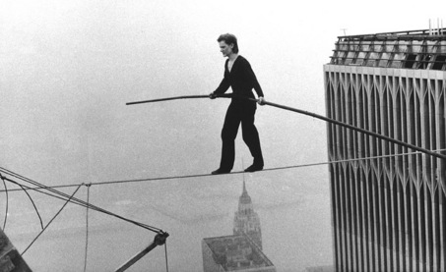
Stabilize
Ensure home learner quality first & foremost.
Identify scheduling gaps

Slide 6
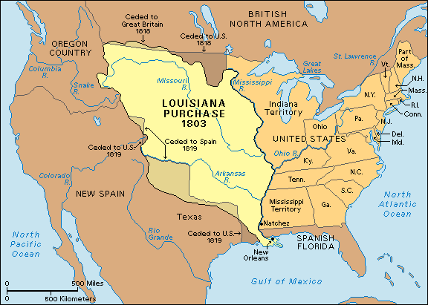
Identify Goals
Long-term technology-based equipment needs
Future internal program expansion

Slide 7

But first….
Administration Buy-in & permission slips
Additional Resources
  Contracts & legal
  Staffing issues

Slide 8
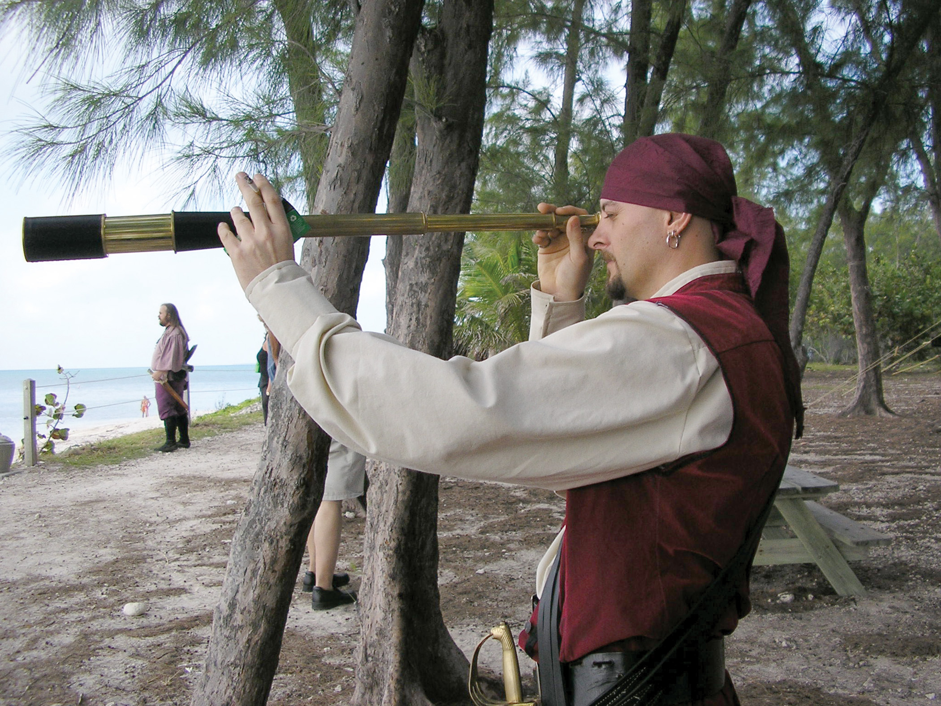
Opportunity Assessment:
Who else is performing Simulation services nearby?
  Who else do they serve?
  What do they charge?
  Could you serve them better?
Who could also use Simulation?
  Local / State / Region / National / International
    EMS / Fire
    Air Transport Service
    Hospitals / Medical Centers
    Military Bases
    Research Grants
Others who could use a simulation facility?
  Media Productions
  Simulation Staff Training days
  Conference Hosting
  Vendors
    Product testing & demos
    Regional Meetings

Slide 9

Traditional Marketing
Study Sales copy
  (Competition & advertisements for products you use)
  Pitching & Taglines
  Short, Detailed & Perspective driven
  Leaders, paragraphs and bullet points
Open Houses & Tours!
Conference presence
  Flyers
Letter campaigns
Word of Mouth

Slide 10

Traditional Marketing

Slide 11

Online Marketing
Video, Video, Video – A million words!
Brochures + graphic design
Website Analytics, email marketing
Testimonials
Key information, FAQs, redirects
Check out CSCLV website
Incentives
Example:
CSCLV "All-in"

Slide 12
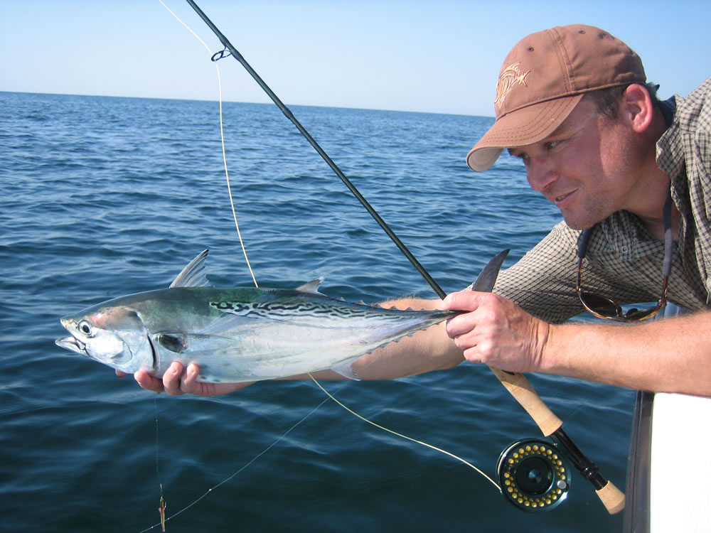
Pilot ahead -> Start small, and get them hooked!
Provide initial low-cost training opportunities
Take what you can get but…
  Who can you help the most, the fastest?
Build & test your program
Remember customer service:
  Catering
  Parking
  Access
  Breaks
  Printed resources
  Prizes
Reflect
  Pre & Post Survey
  Grab testimonials
  Record interviews

Slide 13

Expand and Start Saying “No”
Learn to Walk away (remember 30% minimum)
Spend less time on 1 day trainings.
Catch bigger fish by negotiating Rates for “Bulk Buys”
Bring in extra hands on deck.
Customer service is key : Holding easier than building anew
Require:
  Use of your technical staff support but…
  Training programs for their clinical educators.
Set a course and navigate obstacles
GET PAID!

Slide 14

Learn and improve
Survey and accept criticism:
What worked, what didn’t?

